Slide 1

Unit 12

Slide 2
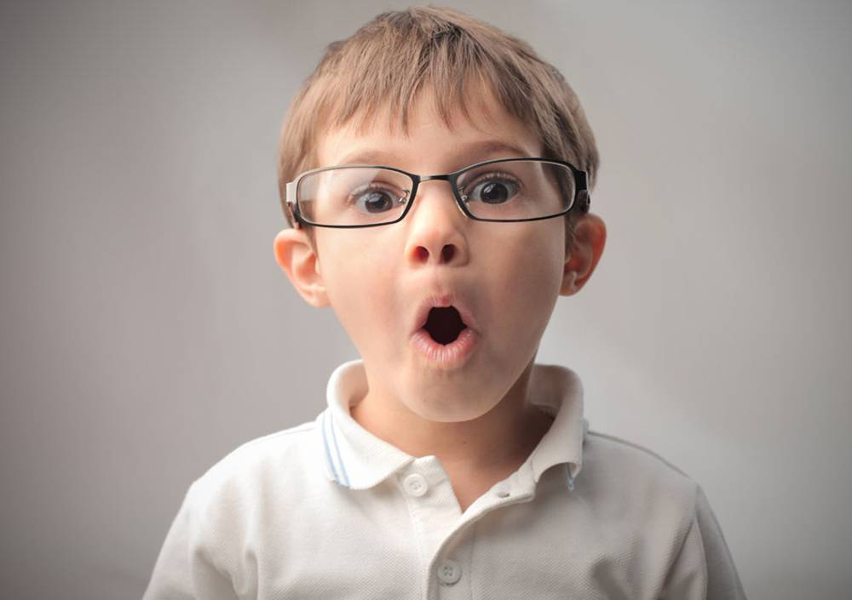
Unit 12
Life is full of the unexpected.

Slide 3

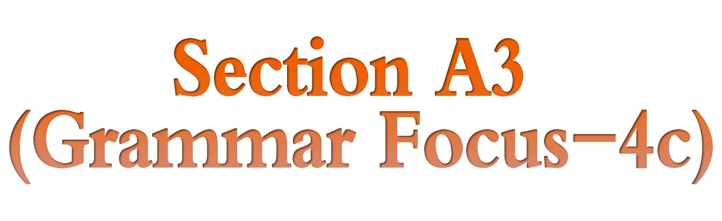

Slide 4


把下列短语翻译成英语。
1. 即将
2. 买杯咖啡
3. 排队等候
4. 起床
5. 出去
be about to
get a coffee
wait in line
get up
get outside

Slide 5
be late for
6. 迟到
7. 在……以前
8. (闹钟) 发出响声
9. 开始做某事
10. 捎……一程
by the time
go off
start doing sth.
give sb. a lift

Slide 6


1. To learn to understand the use of Past perfect tense
2. To be able to write sentences using by the time or before

Slide 7


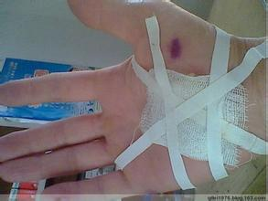
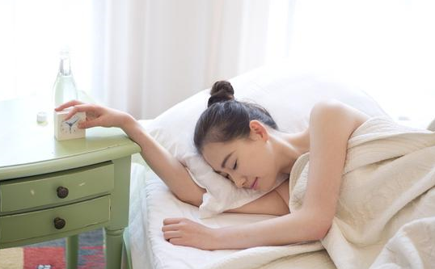
First, I had slept when the clock went off.
Then by the time I had breakfast, I had hurt my hand with a knife.
Before I went to school, I had gone to the doctor.
What happened to you
on a bad morning?

Slide 8
过去完成时
过去完成时的构成：
肯定式为：助动词had+过去分词
否定式为：had not+过去分词
had not缩写为hadn't

Slide 9
过去完成时的用法：
1) 表示一个动作或状态在过去某一时间或动作之前已经完成，发生在“过去的过去”。这个过去的时间可以用by，before等介词短语或者一个时间状语从句来表示。
e.g. When I woke up, it had stopped
raining. (翻译)
我醒来时，雨已经停了。

Slide 10
2) 表示某一动作或状态在过去某时之前已经开始，一直延续到这一过去的时间。常用表延续的时间状语如：
by the end of+ 过去的时间点，by the time +从句等。
e.g. By the end of last year, she had worked
in the factory for twenty years. (翻译)
到去年年底，她已经在这家工厂工作
20年了。

Slide 11


根据汉语提示完成句子。
1)当我到达学校的时候，我才意识到我把书包忘在家里了。
_______ I got to school, I realized that I
______ ______ my backpack at home.
2)到我返回学校的时候，铃声已经响过了。
_____ _____ _____ I got back to school, the bell ______ _______.
When
had
left
By the time
had rung

Slide 12
3) 我到达公共汽车站之前， 汽车已经离开了。
Before I _____ _____ the bus stop, the
bus ______ _______ _______.
4) 我决定先买一杯咖啡，然后再去办公室。
I ______ ______ ______ go up to my office when I decided to get a coffee first.
got to
had
already left
was about to

Slide 13
5) 就在我和别的工作人员一起排队等候 的时候，听到了一个巨大的声响。
As I ______ _______ ______ ______ with the other office workers, I
______ _____ _____ ______.
was waiting in line
heard a loud sound

Slide 14
Notes：
1. 由when, by the time, before等引导时间状语从句时，若描述发生在过去的事，主句常用过去完成时(had + 过去分词)表示动作发生在过去的过去。
2. be about to do, be doing等表示即将或正在做某事时，常用when引导从句表示突然发生的动作，when有时可省略。

Slide 15
现在完成时与过去完成时的区别：
现在完成时表示的动作发生在说话之前某
个没有明确说出的过去时间，侧重过去发
生的动作对现在产生的影响或造成的结果，与现在有关；
过去完成时的动作发生在“过去的过去”，
它是一个相对的时态，不能离开过去的时
间而独立存在。

Slide 16
e.g. We have learned 1,000 English words
so far.
We had learned 1,000 English words
by then.

Slide 17

1. The world is changing with every second; and China, too, ______with every second. (2019 湖南株洲)
is changing B. had changed
C. changed

Slide 18

2. I ate some fruit, which I ______ since I was a child, and the vegetables from my garden.
(2019湖北武汉)
have enjoyed B. enjoyed
C. enjoy D. had enjoyed
3. He ______ his English teacher when he was sightseeing in Paris. (2019湖北武汉)
has met B. had met
C. met D. would meet

Slide 19
4. —Why won’t we play basketball with Class 4 this afternoon?
— Because they _______ Longzhong for a study trip. (2019 湖北襄阳)
A. have gone to B. have been to
C. had gone to D. had been to

Slide 20

Make sentences using by the time or before.
4a
1. Tim went into the bathroom. Mary got up.
By the time Mary got up, Tim had already gone into the bathroom.
2. The coffee became cold. I put cream (n. 奶油) in the coffee.
_________________________________
_________________________________
Before I could put cream in the coffee, the coffee had become cold.

Slide 21
3. The teacher collected the math homework. I got to school.
__________________________________
__________________________________
4. I completed the work for my boss. The workday (n. 工作日) ended.
__________________________________
__________________________________
By the time I got to school, the teacher had collected the math homework.
I had completed the work for my boss before the workday ended.

Slide 22
5. The movie started. I arrived at the cinema.
_________________________________
_________________________________
6. My mother finished making the apple pie. I got home from my language course.
__________________________________
__________________________________
__________________________________
The movie had started before I arrived at the cinema.
By the time I got home from my language course, my mother had finished making the apple pie.

Slide 23
Fill in the blanks with the correct forms of the words in the box.
4b
rush out, forget, arrive at, go into,
show up (赶到；露面), find out
1. By the time I arrived at the party, everyone else _____ already __________.
2. When he put the noodles into a bowl, he realized he ____________ to add the green beans (n. 豆).
had
shown up
had forgotten

Slide 24
rush out, forget, arrive at, go into,
show up (赶到；露面), find out
3. By the time my mother came back from the market (n. 市场), I ______ already __________ of the door to go to my piano lesson.
4. Before she got to the airport, she ____________ about the earthquake.
had
rushed out
had found out

Slide 25
rush out, forget, arrive at, go into,
show up (赶到；露面), find out
5. When she _________ the movie theater, she remembered she had forgotten to feed her dog.
6. Before she got a chance to say goodbye, he ____________ the building.
arrived at
had gone into

Slide 26
4c
Write two true statements and one false statement about your day yesterday. Then ask your classmates to guess the false statement.
1. By the time I left for school in the morning, __________________________________
__________________________________
__________________________________
I had already had breakfast.
I had already brushed my teeth.
I had already finished my homework.

Slide 27
2. By the end of the school day,
__________________________________
__________________________________
__________________________________
3. By dinner time, I_________________________________
I_________________________________
I_________________________________
I had finished my homework.
I have got a present from Tom.
I had had these articles read.
had had too many apples.
had eaten plenty of meat.
had all the housework finished.

Slide 28


1. 过去完成时的构成：_____+___________
2. 过去完成时表示：
__________________________________
__________________________________
3. 过去完成时常与______________________等引导的时间状语连用。
had
过去分词
过去某一时刻或动作之前已经发生或完成的动作。
when, before, by the time

Slide 29
show up
by the end of
露面；赶到
在(某时间点)以前
句型
When I got to school, I realized that I had left my backpack at home.
By the time I got back to school, the bell had rung.
Before I got to the bus stop, the bus had already left.

Slide 30
I was about to go up to my office when I decided to get a coffee first.
As I was waiting in line with the other office workers, I heard a loud sound.

Slide 31


根据短文内容及括号内所给动词的提示，用正确的时态或语态补全短文，使短文完整、通顺。
A cow and a fox went out to search for food together. They (1)_________(go) only a few miles before they saw a lion coming their way. They were both very scared. The fox thought of a way to save his own life, and went up to the lion and said in his ear,
had gone

Slide 32
“I (2)_________(help) you catch the cow without the trouble of hunting (猎杀) him, if you let me go free.” The lion agreed, and the fox then led the cow to a hidden pit (深坑), which some hunters (3)_________(dig) as a trap (陷阱) for wild animals, and the cow fell into it. When the lion saw that the cow (4)______________(catch) and couldn't get away, he turned his attention to the fox. He soon killed him, and then went on to eat the cow.
Betray (背叛) a friend, and you'll often find you have ruined (毁灭) yourself.
will help
had dug
had been caught

Slide 33


1. 复习Grammar Focus 中的内容。
Try to make sentences with before, by the time and be doing … when, and you can use the past perfect tense in your sentences.
2. Preview 1a-2a on page 93.

Slide 34


